Slide 1

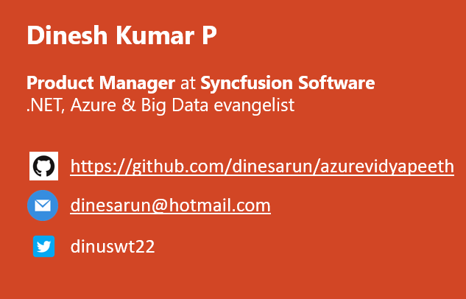
Big Data and Business Intelligence
Notes:
Good afternoon guys. Ya. I am Dinesh Kumar. Product Manager at Syncfusion Software. I manage ‘Data sources’ division of Data Platform team. And I am pretty happy to present this Webinar in Azure Vidyapeeth to this wonderful audience. Here we go!

Slide 2
https://tinyurl.com/y3gr44z9

Slide 3
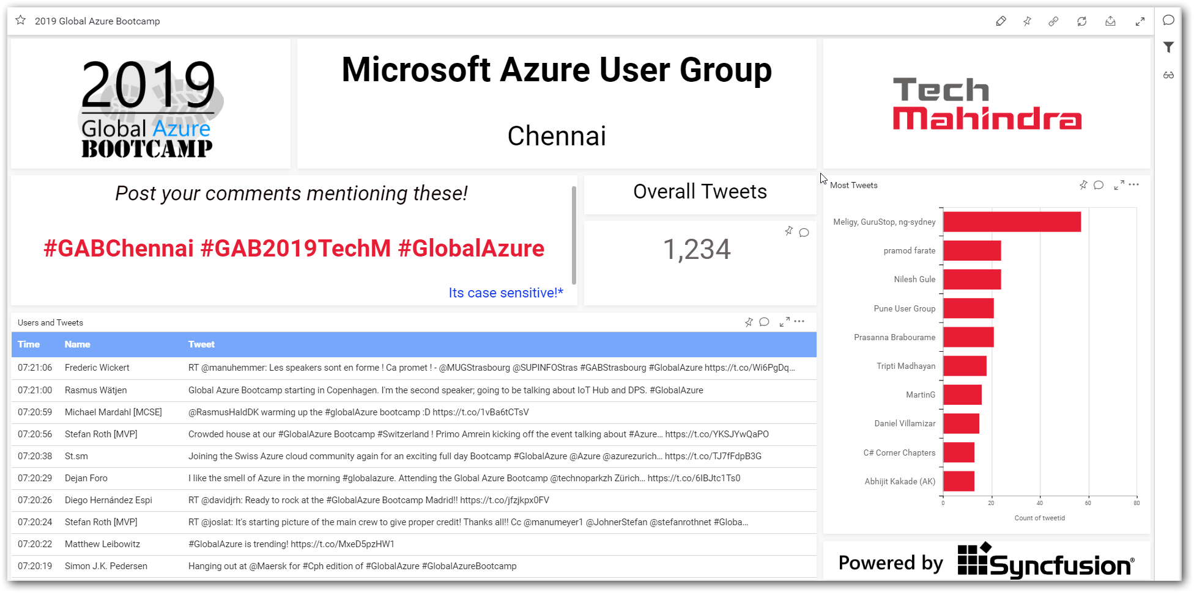

Slide 4
Agenda
Data Scientist
Data Analyst
ML Engineer
Data Admin
Data Engineer
Notes:
Can see as story that revolves around the work of these roles.
Big Data - is not actually about technology or Software, its THINKING.

Slide 5
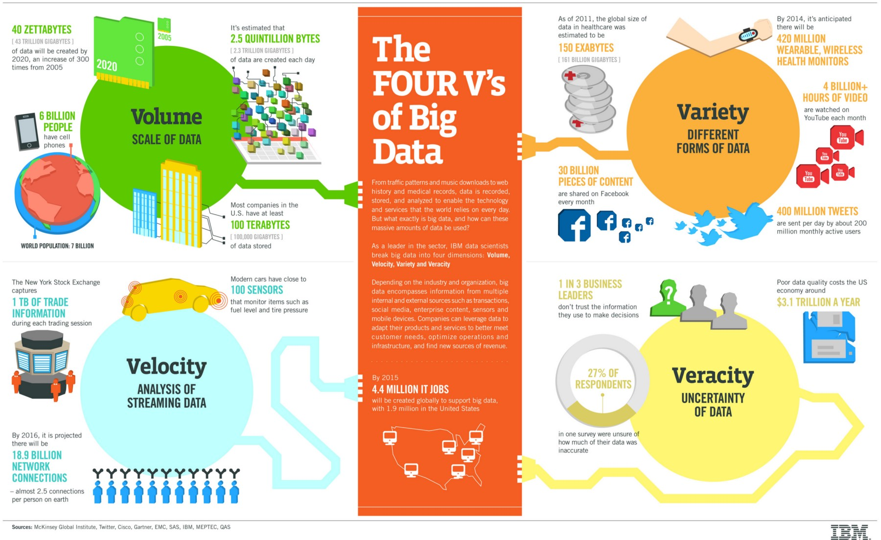
Notes:
Not only its for Big Data, its for Data science as well.

Slide 6
Domains, Industries
Marketing
Sales and CRM
Web Analytics
Ecommerce
Advertising
IT
Finance
Healthcare
Social Media
SEO
Banking
Human Resources
Mobile Analytics
Project Management
Research and Development
Support
Survey
Insurance
Manufacturing
Energy
Oil & Gas
Pharmaceuticals
Public Sector
Retail
Communications
Food and Beverages
Education
Media
Technology
Transportation and Logistics
Notes:
Different domains now a days produces different KINDS of data. Upon which all cannot be fit into traditional SQL based database systems.

Slide 7
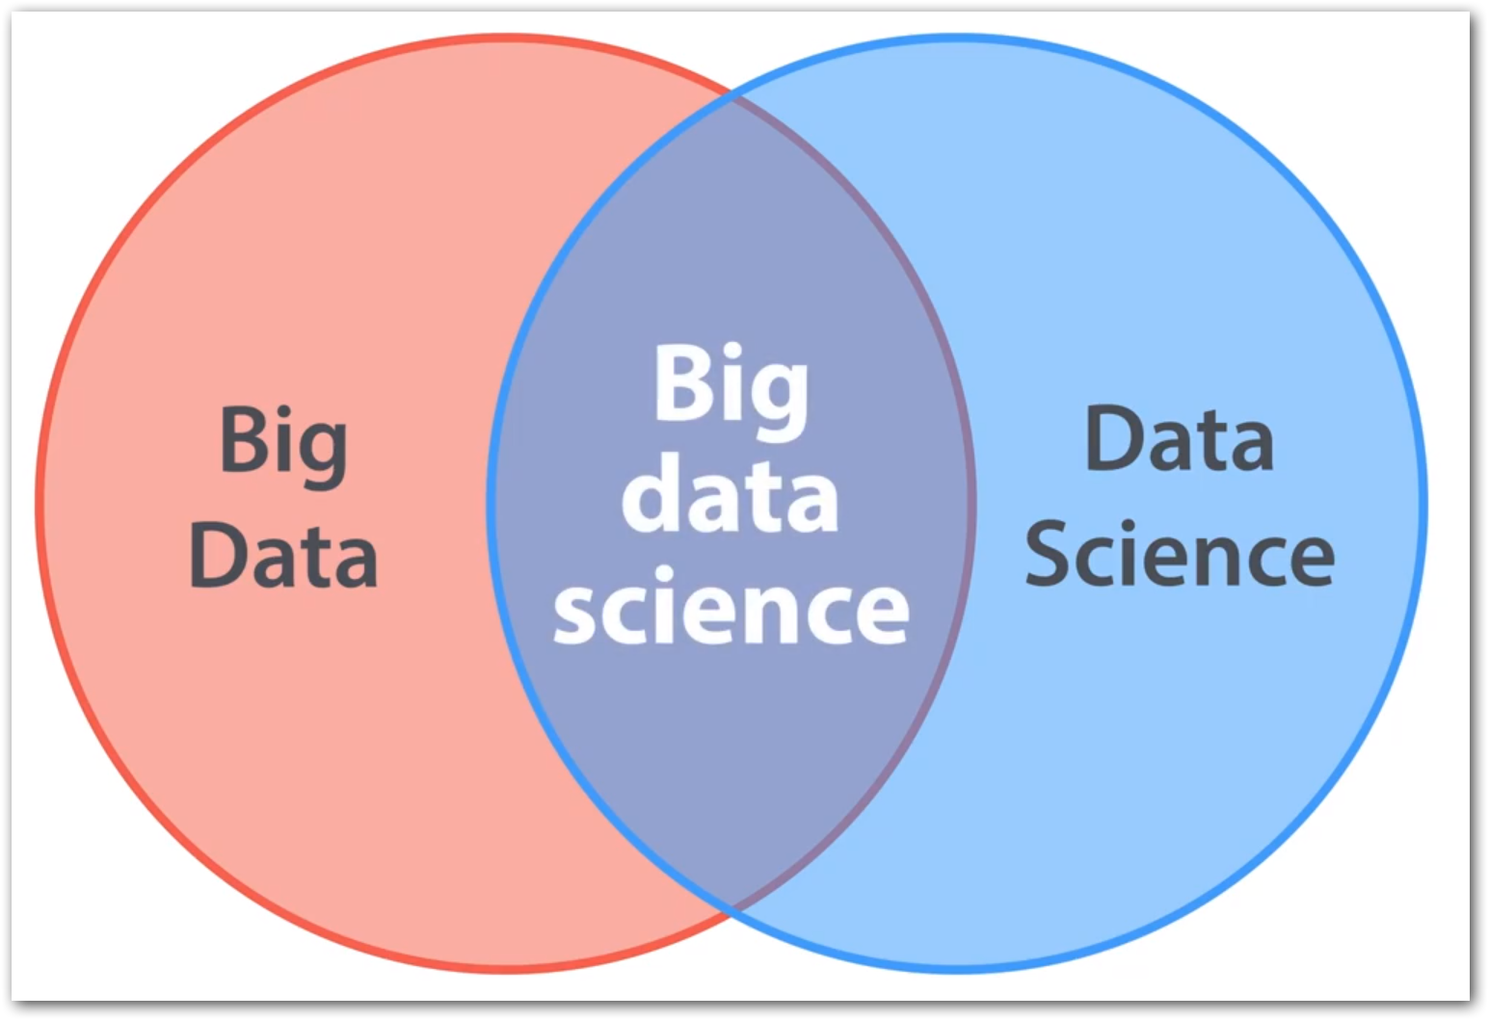
Big Data vs Data Science
Big Data + Data Science = Big Data Science
Big Data ≠ Data Science
Big Data <- All 4 Vs;
E.g. Shares trading, E-Shopping
Data Science <- 1 or 2 Vs;
E.g. ML use cases like Genetics data, Credit card fraud detection – Volume

Slide 8

Why Big Data?
Cost reduction
Hybrid storage options,
Mostly used – SQL Server
Rarely used like logs – Azure Blob
AI , Analytics, Cloud are also in picture of Big Data.
Empowers to make better decisions analyzing more about their work.
Notes:
Cost reduction - Big data technologies such as Hadoop and cloud-based analytics bring significant cost advantages when it comes to storing large amounts of data.

Slide 9
Why BigData?: SQL Comparision
Hadoop | SQL
Schema on Read | Schema on Write
Data stored as Compressed form as txt / csv or any form. | Stored as logical forms and inter related columns
Distributed processing. E.g. Twitter Hashtag search happen over 1000 servers, ok if miss some tweets due to unavailability of 1 of 60 nodes | Two phase commit. Consistency across all nodes. Necessary in cases like, Transaction(Banks), Share market

Slide 10

Data engineer’s routine work
2. Identify source(s) of Data
4. Storage & Access
5. Processing
6. Visualization
3. Data Integration
1. Defining Objective

Slide 11

Use case
An insurance firm.
Grown over the years through acquisition of many small insurance companies - hence, it doesn’t have a single, consolidated view of their customer base.
Also details are fragmented among many subsystems, product lines -
Health insurance,
Vehicle insurance,
Pet insurance, etc.
So plans to build a data lake.
Data scientists or BI analysts to generate insights.
From: https://www.thoughtworks.com/insights/blog/curse-data-lake-monster
Notes:
Different file formats.
Different reporting tools.
Different data types – Phone calls, Logs, Feedbacks.

Slide 12
1. Defining Objective
Understand the domain & industry,
Discuss about the business need / problem,
Ask more and more WHYs?
Prepare the objectives.

Slide 13
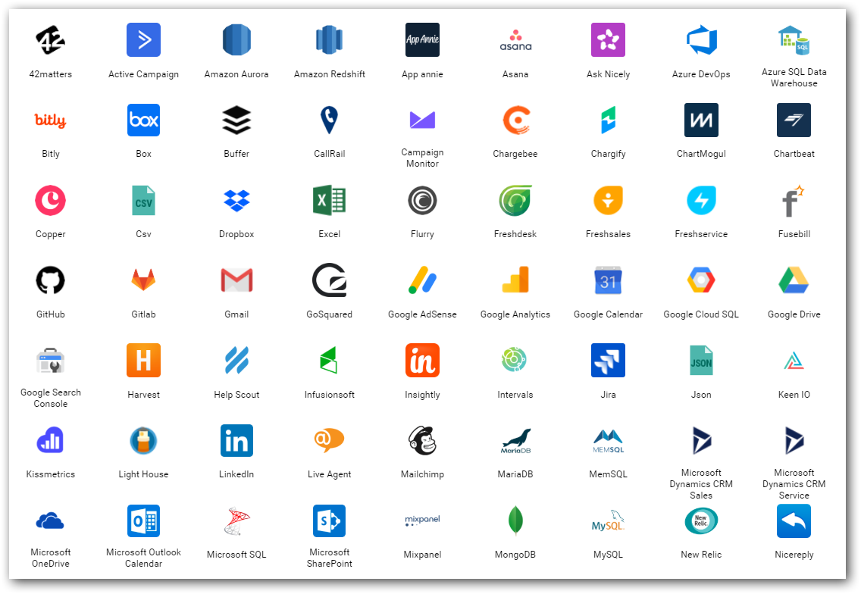
2. Data source(s)
Find out from where you need to get the data for your project.
Either provided or should search and find.
Logs
Databases
Web (REST APIs)
Social Media
…
Notes:
Logs – NASA logs which we gonna process.

Slide 14
3. Data Integration
Required data would exist in different sources those need to be brought to one place for,
Gather
Clean
Prepare
Tools
Apache Sqoop
Azure Data Factory
Informatica
Apache Nifi…

Slide 15
4. Storage & Access
Different stages
Initial
Processing
Final
Instances & Services
Cloud Database instances (SQL Server, MySQL,..)
Azure Blob
Azure Data Lake…
Access
API
Integration between processing tools

Slide 16
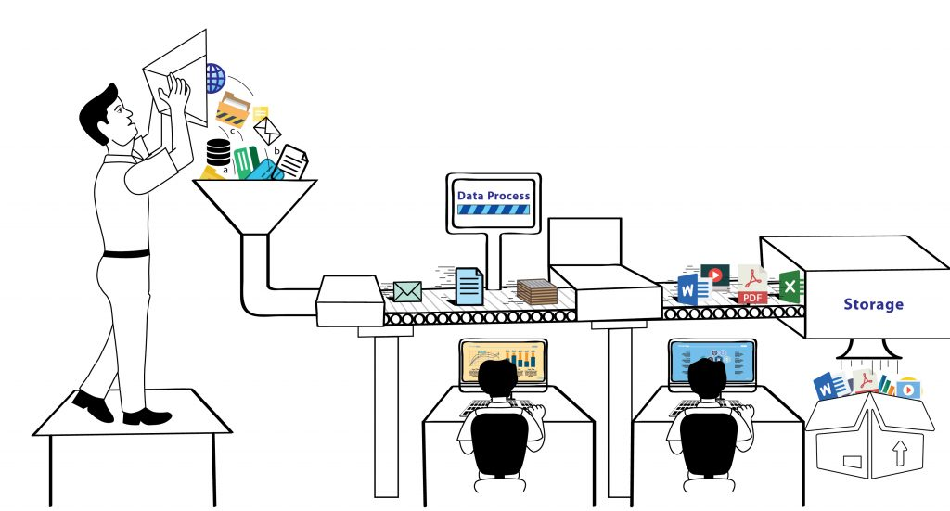
5. Process
Analyze / Do Analytics
ML models
Map Reduce
Tools & Services
Apache Pig
Azure HDInsight
Azure Databricks
Azure ML Studio

Slide 17
6. Visualize
BI tools for business decisions
Microsoft PowerBI
Tableau
Qlik
Syncfusion Dashboards
…
In-built packages in R, Python

Slide 18
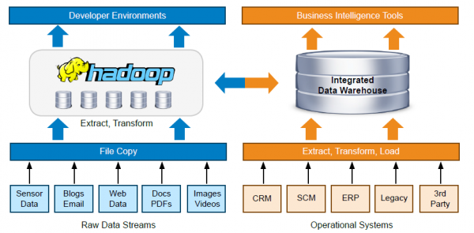

Slide 19

Big Data in Cloud
Dynamic scalability - Go with perfectly sized cluster(environment) only when needed.
Famous vendors,
Microsoft Azure,
Amazon Web Services,
Google Cloud Platform
Cloud database options

Slide 20
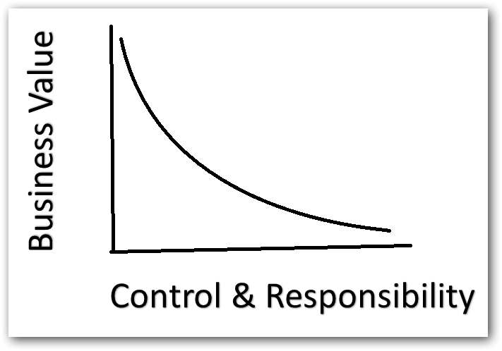
Control & Responsibility over Business Value
Simple analogy,
Build a car?
Buy a car?
Rent a car?

Slide 21
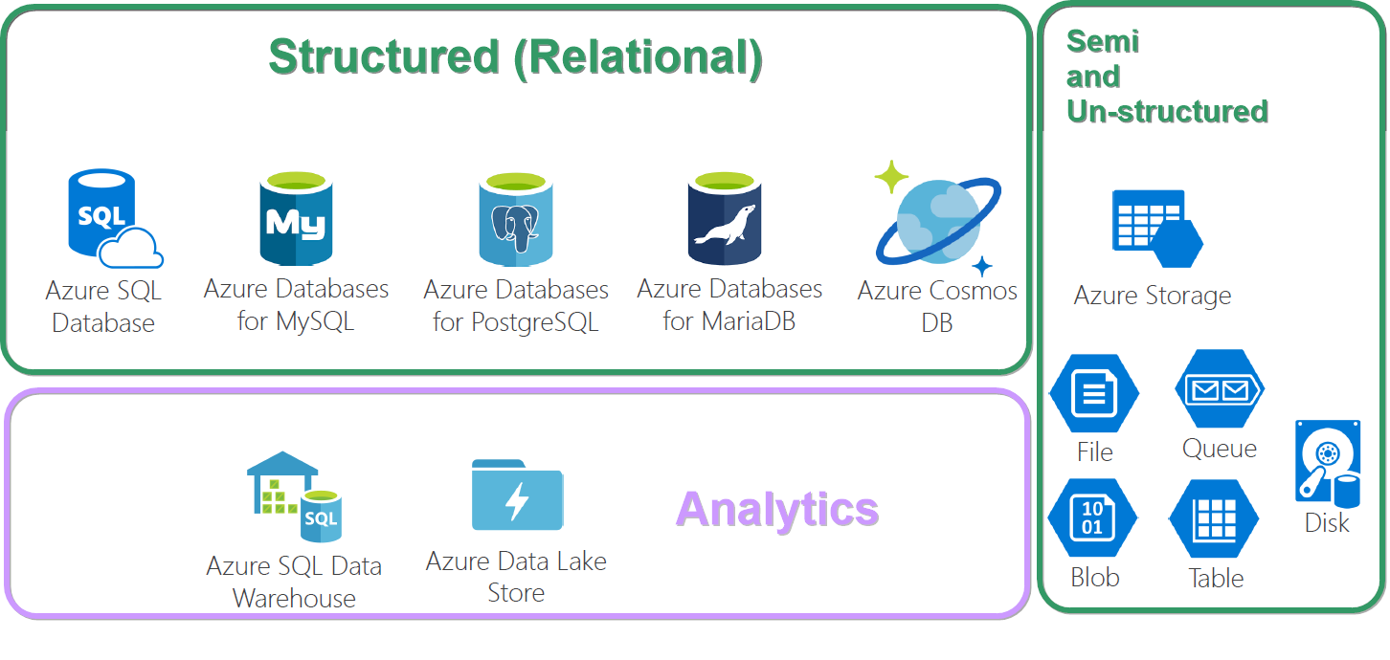
Database options in Azure

Slide 22

Importance of Business Intelligence and Visualization
Transform the data into charts, images,… that explain the numbers and allow us to get insights from it.
Giving meaning and purpose to the original raw data.
Discovers patterns and spot trends.
Can see in a glimpse about Past, Current and Future with the data.
Thousands of rows in an Excel spreadsheet easily can be conveyed in a bar chart / pie chart.

Slide 23
